Slide 1
Mann-Whitney U Test
By: Ryan Anderson, Zack Guinn, Tyler Kozisek & Candace Sorden
Notes:
Candace

Slide 2
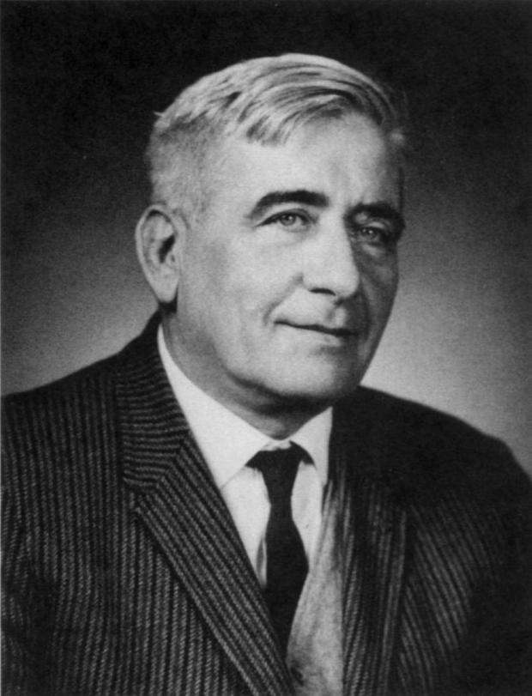
History
Introduced by Mann and Whitney in 1947.
Henry Mann
Mathematics and statistics professor at Ohio State University
He and his student, Donald Whitney, developed this test
Notes:
Candace

Slide 3
How can this test be utilized?
It can be used to compare the means of two populations
Why not use a two sample t-test?
A researcher does not have to assume that the difference between the samples is normally distributed, or that the variances of the two populations are equal.
It is most commonly done on ordinal data.
Notes:
Candace

Slide 4
What to know before testing the two populations
The Mann-Whitney test is based on the comparison of each observation from the first group with each observation in the second group.
This means, the data must be ranked in ascending order.
Three assumptions must be made:
1. Random selection
2. Independent samples
3. Ordinal or Continuous data type
Notes:
Candace

Slide 5
Hypothesis
H₀: µ₁ = µ₂
H₀: µ₁ ≤ µ₂
H₀: µ₁ ≥ µ₂
H_{a}: µ₁ ≠ µ₂
H_{a}: µ₁ > µ₂
H_{a}: µ₁ < µ₂
Reject if U ≤ U_{n1,n2}
}
One-tailed Test
Notes:
Ryan

Slide 6
Steps to using the Mann-Whitney U Test
Step 1: Rank all scores together, ignoring which group they came from.
Step 2: Add up the ranks for group 1 to get R₁.
Step 3: Add up the ranks for group 2 to get R₂.
Step 4: Select the larger rank total, R_{x}.
Step 5: Calculate N₁, N₂, and N_{x}, where N₁ and N₂ are the sample sizes for group 1 and 2, respectively, and N_{x} is the sample size of the group with the largest rank total.
Step 6: Calculate the U value for the two groups, making sure to use the correct N_{x} and R_{x}.
Step 7: Use the Mann-Whitney U Test table to find the critical U value.
Step 8: Compare critical U value to calculated U value. There’s only a statistical difference if U calculated is LESS THAN or EQUAL TO U critical.
Notes:
Ryan
1.45

Slide 7
Statistic Defined
Where:
U = Mann-Whitney U test
N₁ = Sample size of group 1
N₂ = Sample size of group 2
R_{x} = Larger sum of ranks
N_{x} = Sample size with larger R
U = N₁*N₂+N_{x}*(N_{x}+1)/2-R_{x}
Notes:
Ryan

Slide 8
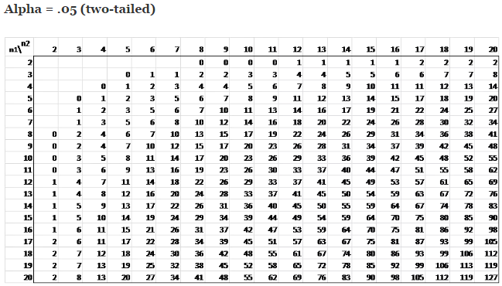
U Test Table
Notes:
Ryan

Slide 9
Mann-Whitney U Example: The Power of Advertising
12 participants at a local mall were shown advertisements for two rival colleges. They were asked to rate the two colleges on the likelihood of them attending that college (out of 10, with 10 being “Definitely going to attend that college”). The participants were split in half at random; half gave ratings for University of Nebraska Lincoln, the other half for University of Iowa. The results can be seen on the following table:
Notes:
file:///C:/Users/zpgui/AppData/Local/Microsoft/Windows/INetCache/IE/Q0TTQ2T1/Mann-Whitney%20worked%20example.pdf
This is a pretty interesting example that has been worked out previously. It does a pretty good job of explaining things.
Tyler
5:35
5:26

Slide 10
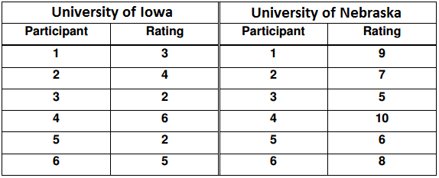
Mann-Whitney U Example: The Power of Advertising
Notes:
Tyler

Slide 11
Can we use the Mann-Whitney U test for this problem?
Are we comparing only two groups? Yes, we are comparing participant’s ratings for Iowa and Nebraska.
Are the samples independent? Yes, each participant only gives ratings for one college, which does not influence the other group’s ratings.
Is the data ordinal? Yes, the data are ratings.
We can use the Mann-Whitney U test!
The hypothesis for this test is H₀: µ₁ = µ₂ and H_{a}: µ₁ ≠ µ₂. We will use an alpha level of 0.05.
Notes:
Tyler

Slide 12
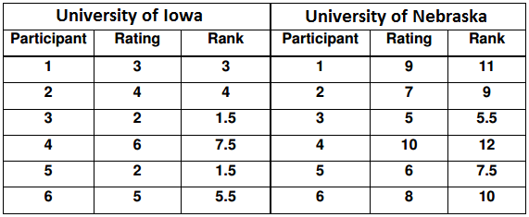
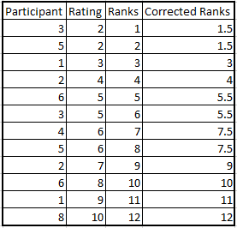
Step 1: Rank all scores together, ignoring which group they came from
Notes:
Tyler

Slide 13
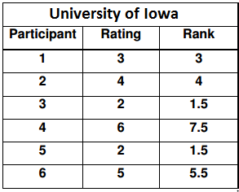
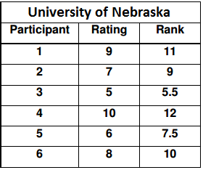
Step 2 and 3: Add up the ranks for the two groups
Iowa: R1=3+4+1.5+7.5+1.5+5.5= 23 Nebraska: R2=11+9+5.5+12+7.5+10=55
Notes:
Zack
8:50

Slide 14
Step 4, 5, & 6: Select the larger R, and calculate U
Nebraska had the larger R at 55.
We need to find N₁, N₂, and N_{x}.
N₁= sample size of group 1 (Iowa)=6
N₂=sample size of group 2 (Nebraska)=6
N_{x}=sample size of group with largest R=group 2 (Nebraska)=6
Equation to find U
U=N₁*N₂+N_{x}*(N_{x}+1)/2-R₂
U=6*6+6*(6+1)/2-55=36+21-55=57-55=2
U=2
Notes:
Zack

Slide 15
Step 7: Use U test table to find the critical value
We need to look at the two tailed U test table for alpha level of 0.05 due to our hypothesis. This gives a critical U value of 5.
Notes:
Zack

Slide 16
Step 8: Compare calculated U to critical U and decide
Our calculated U was 2.
The critical U was 5.
In order for their to be significance, our calculated U value needs to be LESS THAN or EQUAL TO the critical U value we found using the table.
Since 2 is less than 5, we can decide to reject the null and conclude that we are 95% confident that their is a statistical difference in the ratings given to each college on the likelihood of attending that college.
Notes:
Zack

Slide 17
Conclusion
Mann-Whitney U test is a nonparametric test comparing two population means.
Data is usually ordinal (hence nonparametric).
State 1 of 3 hypothesis that you would like to test.
Follow the 8 steps to test your hypothesis
You’re done!
Notes:
Candace

Slide 18
Resources
Mann-Whitney U-test / Mann-Whitney-Wilcoxon. (2016). Explorable.com. Retrieved 29 November 2016, from https://explorable.com/mann-whitney-u-test
Mann–Whitney test - Oxford Reference. (2016). Oxfordreference.com. Retrieved 29 November 2016, from http://www.oxfordreference.com/view/10.1093/oi/authority.20110803100131510
Nachar, N. (2008). The Mann-Whitney U: A Test for Assessing Whether Two Independent Samples Come from the Same Distribution. Tutorials In Quantitative Methods For Psychology, 4(1), 13-20. http://dx.doi.org/10.20982/tqmp.04.1.p013
Olson, John (1977). "Henry B. Mann (with photograph)". In Zassenhaus, Hans. Number theory and algebra: Collected papers dedicated to Henry B. Mann, Arnold E. Ross, and Olga Taussky-Todd. New York-London: Academic Press [Harcourt Brace Jovanovich, Publishers]. pp. xx–xxv. ISBN 0-12-776350-3. MR 469653
Mann-Whitney U test worked example. Retrieved 3 December 2016, from http://users.sussex.ac.uk/~grahamh/RM1web/Mann-Whitney%20worked%20example.pdf

Slide 19
Questions?
Notes:
Possible questions?
What are some drawbacks of using this test?
when the sample size is similar or when the smallest manpower has the greatest variance, the t‐test is more powerful
Source: Nachar.

